Slide 1
Image Compression
Lecture 40-41, 13-Nov-18
JPEG, MPEG …
Dr. Partha Pratim Das
Department of Computer Science and Engineering of
Indian Institute of Technology, Kharagpur

Slide 2
Source & Credit
Adopted from “DMET 1001 Image Processing” Material of German University at Cairo as published at:
http://met.guc.edu.eg/Courses/Material.aspx?crsEdId=235
It also liberally uses information, data and image samples from DIP, 3E

Slide 3
COMPRESSION FUNDAMENTALS
Redundancy & Compression

Slide 4
Compression
Why do we need compression?
For efficient storage.
For efficient transmission.

Slide 5
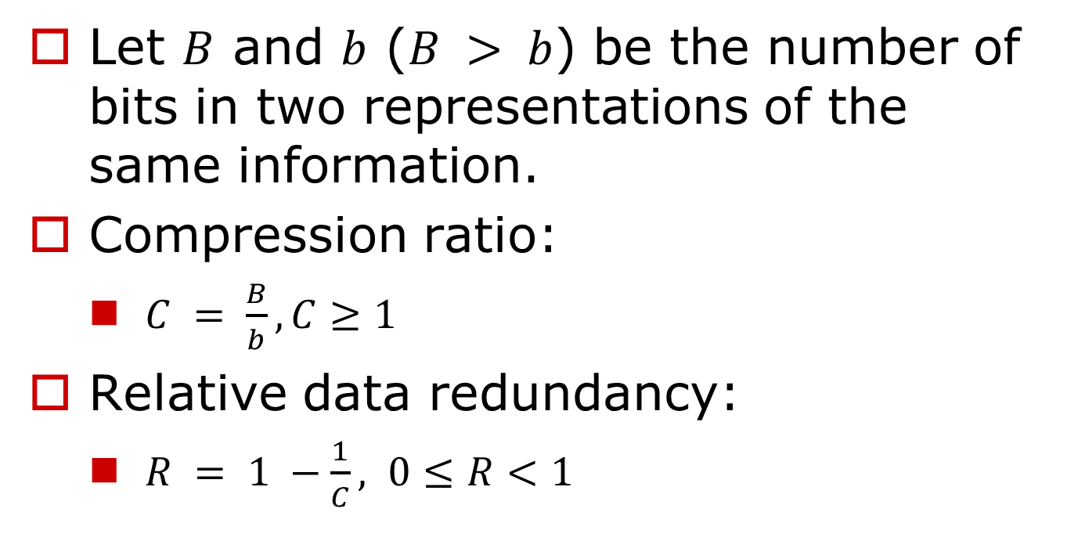
Compression

Slide 6
Compression
Why Is It Possible?
The redundancy is used for compression.
The higher the redundancy, the higher the compression.

Slide 7
Compression
Why Is It Possible?
Images may include:
Information-Theoretic / Coding Redundancy
Inter-pixel Spatial redundancy
Inter-pixel Temporal Redundancy
Psychovisual redundancy

Slide 8
Compression
Coding Redundancy:
Coding redundancy is associated with the representation of information.
The information is represented in the form of codes.
If the gray levels of an image are coded in a way that uses more code symbols than absolutely necessary to represent each gray level then the resulting image is said to contain coding redundancy.
Inter-pixel Spatial Redundancy:
Interpixel redundancy is due to the correlation between the neighboring pixels in an image.
That means neighboring pixels are not statistically independent. The gray levels are not equally probable.
The value of any given pixel can be predicated from the value of its neighbors that is they are highly correlated.
The information carried by individual pixel is relatively small. To reduce the interpixel redundancy the difference between adjacent pixels can be used to represent an image.

Slide 9
Compression
Inter-pixel Temporal Redundancy:
Interpixel temporal redundancy is the statistical correlation between pixels from successive frames in video sequence.
Temporal redundancy is also called interframe redundancy. Temporal redundancy can be exploited using motion compensated predictive coding.
Removing a large amount of redundancy leads to efficient video compression.
Psychovisual Redundancy:
The Psychovisual redundancies exist because human perception does not involve quantitative analysis of every pixel or luminance value in the image.
It’s elimination is real visual information is possible only because the information itself is not essential for normal visual processing.
Irrelevant information

Slide 10

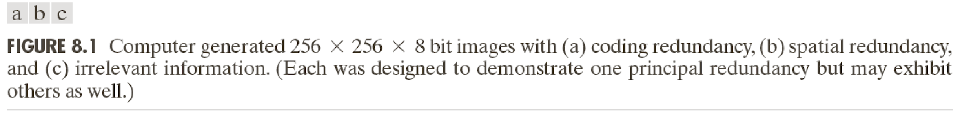
Compression Examples

Slide 11

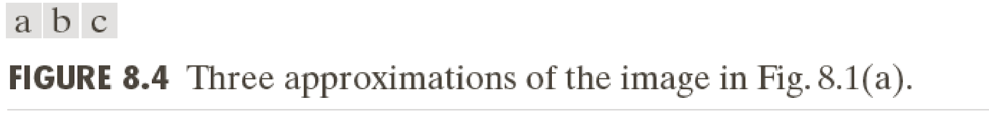
Compression Examples
Coding Redundancy

Slide 12
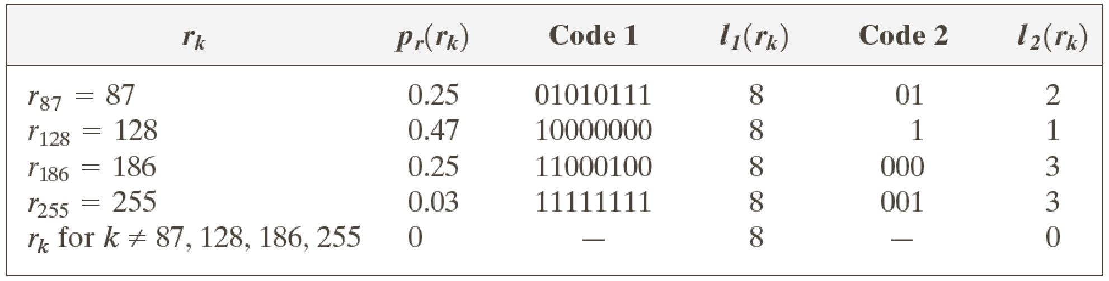
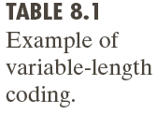
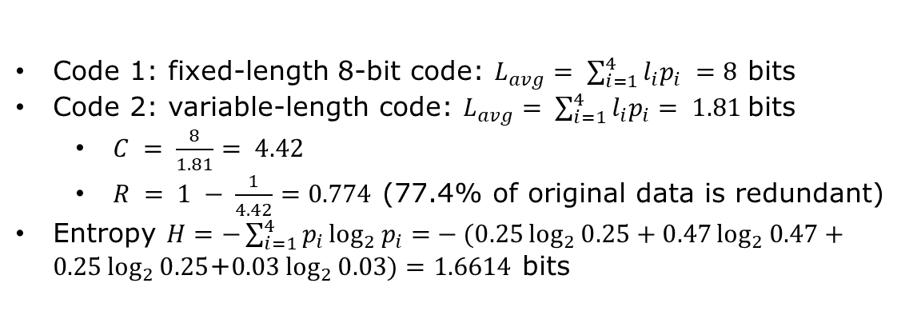
VLC Example
Coding Redundancy

Slide 13
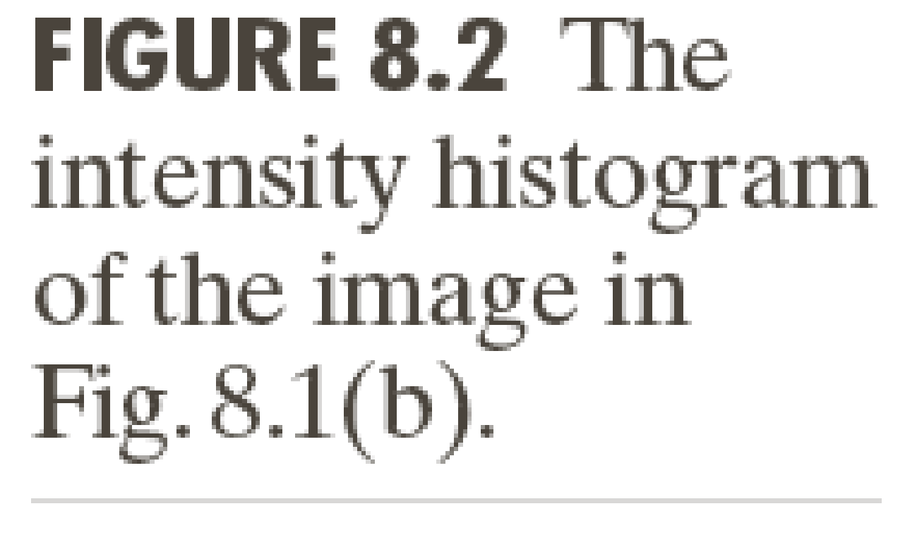
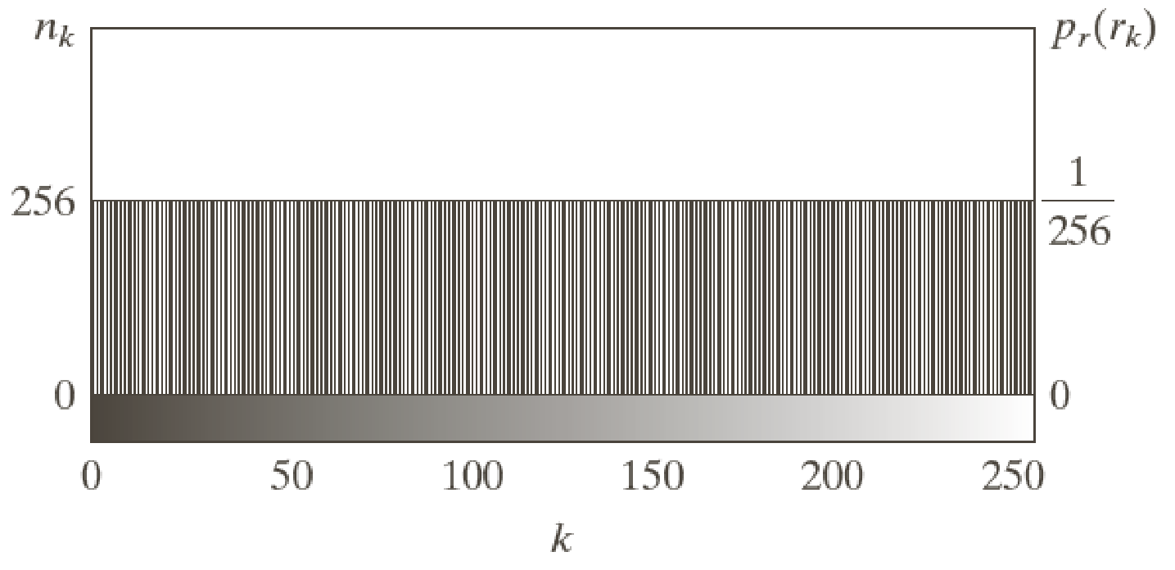

Compression Examples
Spatial Redundancy

Slide 14
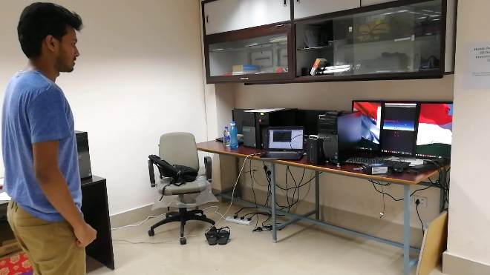
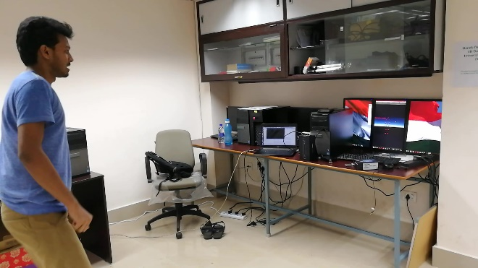
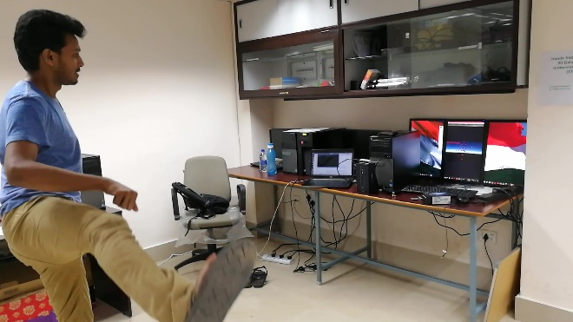
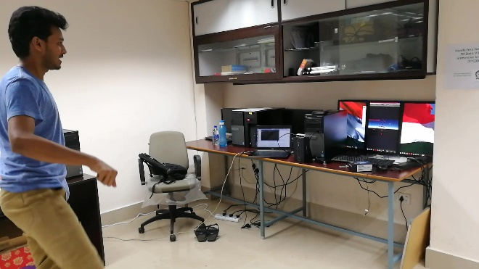
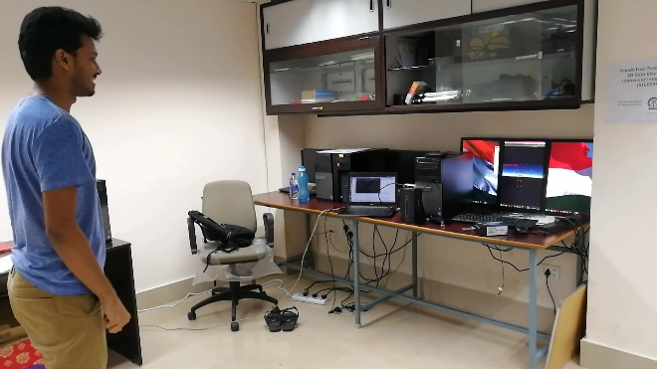
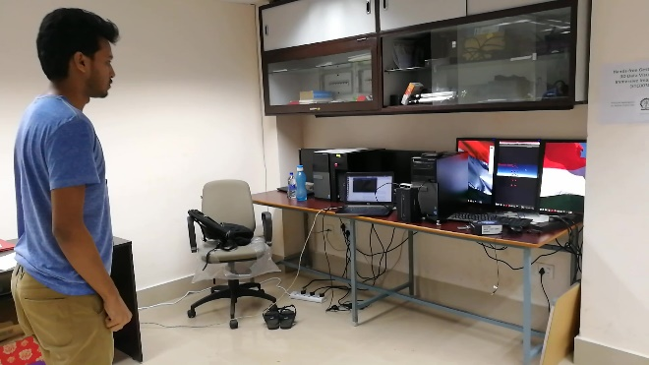
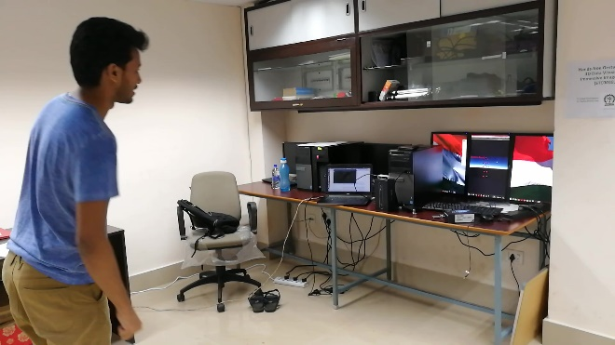
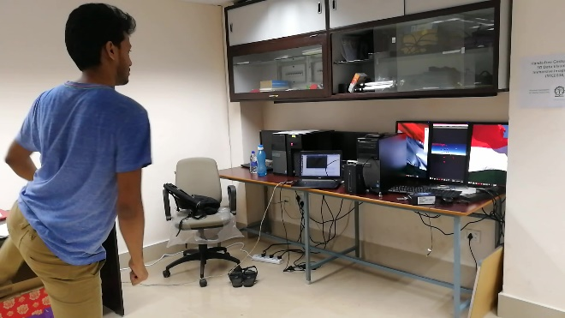
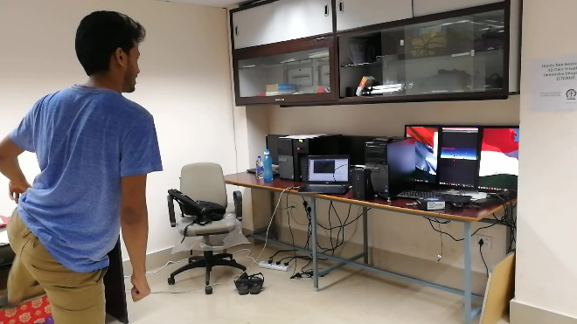
Compression Examples
Temporal Redundancy
VID_20181111_001447 24 – 32.jpg

Slide 15
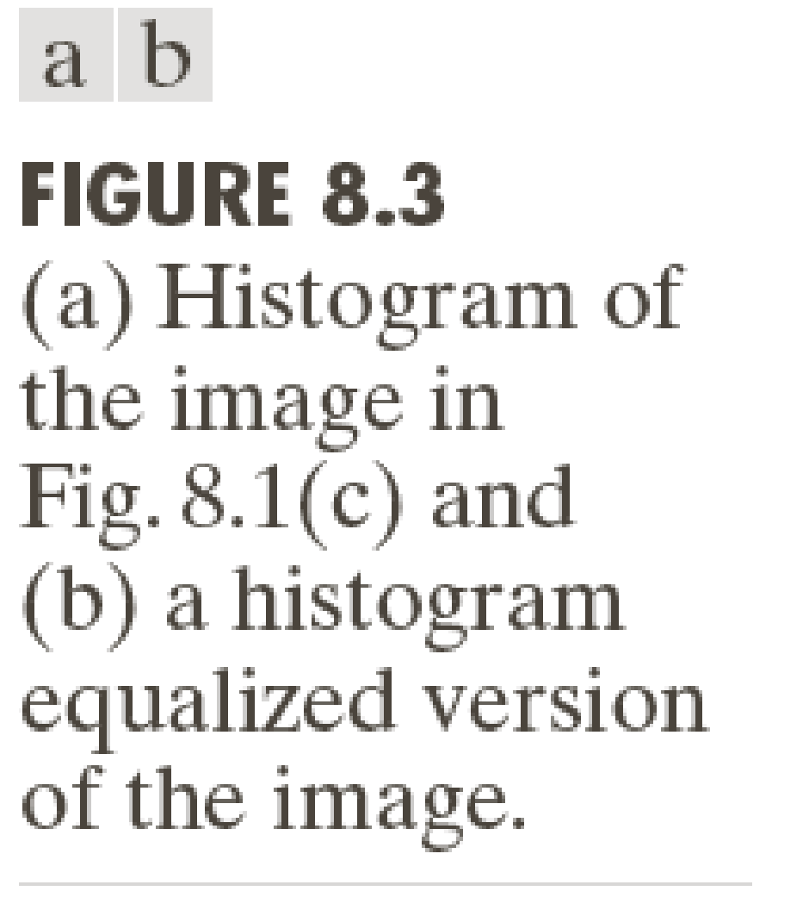

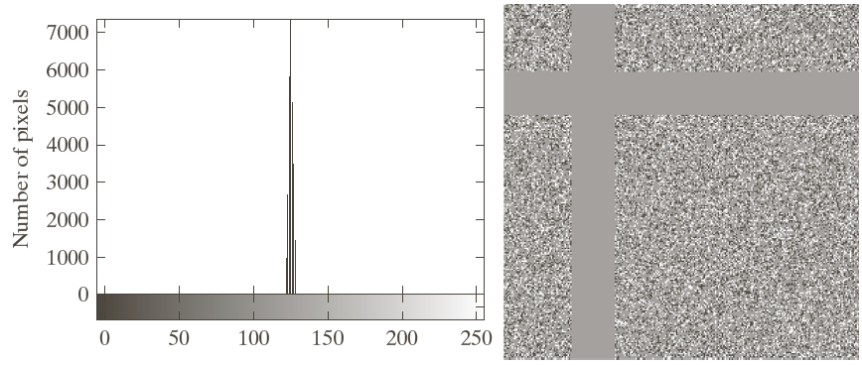
Compression Examples
Psychovisual Redundancy

Slide 16
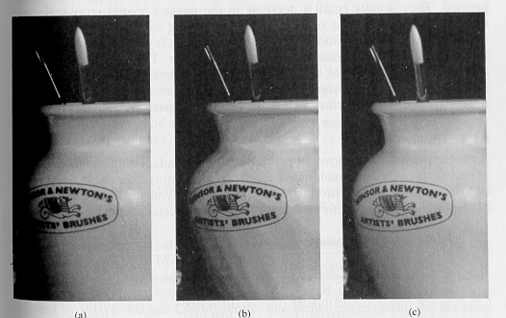
Psychovisual Redundancy
16 levels + random noise pre-quantization
Example: Quantization
256 levels
16 levels

Slide 17
Lossless vs. Lossy Compression
Lossless compression
Minimize the bit rate without causing distortion.
The same quality is maintained.
Lossy compression
Get best fidelity for a given bit rate
Get minimum bit rate for a given fidelity

Slide 18
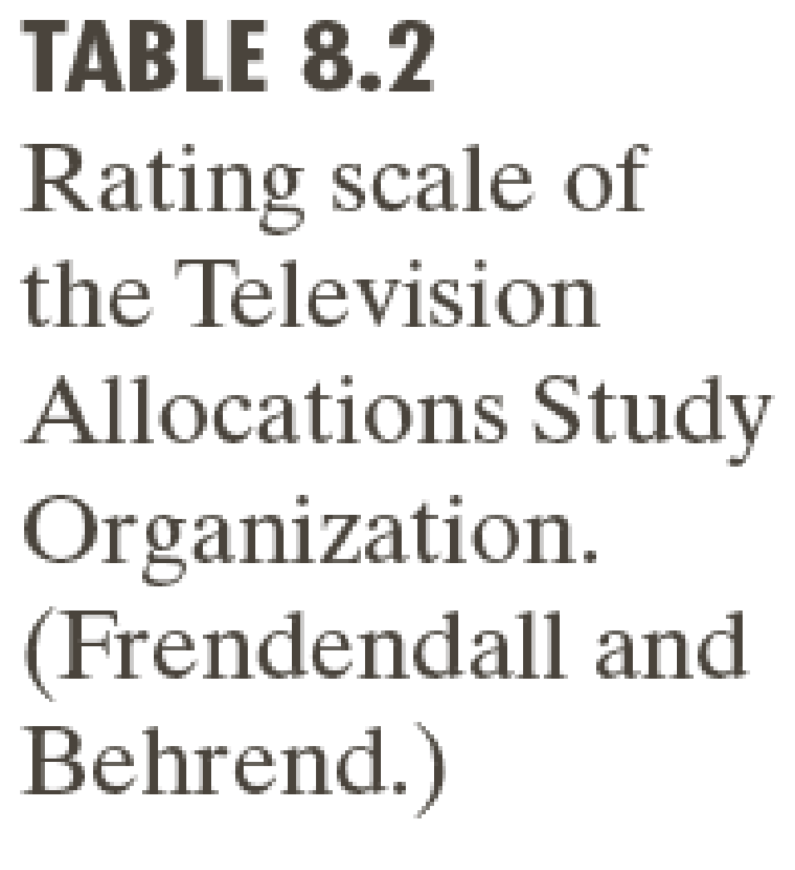
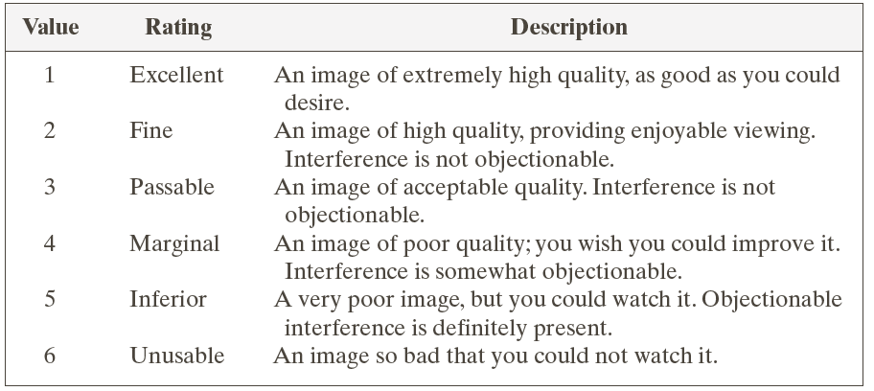
Compression Examples

Slide 19
LOSSLESS COMPRESSION
Information Preserving Schemes (Bi-Level Images)

Slide 20
Lossless Compression: Symbol Coding
Fixed-length coding:
Fixed-length codes → Fixed-length blocks
Variable-length coding (VLC):
Example: Huffman coding
Variable-length codes → Fixed-length blocks
Example: Arithmetic coding
Variable-length codes → Variable-length blocks
Example: LZW coding
Fixed-length codes → Variable-length blocks

Slide 21
HUFFMAN CODING
Variable Length Code for Fixed Length Blocks

Slide 22
Huffman Coding
Length = 0.4*1+0.35*2+0.2*3+0.05*3
1.85 bits / symbol
Entropy = –(0.4*lg0.4+0.35*lg0.35+ 0.2*lg0.2+0.05*lg0.05)
1.7394 bits / symbol
Symbol | Probability | Code
a | 0.4 | 0
b | 0.35 | 10
c | 0.2 | 110
d | 0.05 | 111

Slide 23
Huffman Coding
Variable Length Minimum Redundancy Prefix Code
Greedy algorithm for Huffman Coding

Slide 24
Huffman Coding: Pros & Cons
Pros
Optimal Entropy Coding by Single Symbol
Extensible to combinations of symbols

Slide 25
Huffman Coding: Pros & Cons
Cons
Optimal only if exact probability distribution of the symbols is known
Length of the codes of the least probable symbol could be very large to store into a single word or basic storage unit in a computing system
The worst case is that the code length of least probable two symbols would be n-1, where n is the number of symbols

Slide 26
LOSSLESS COMPRESSION
Information Preserving Schemes (Gray-Scale Images)

Slide 27
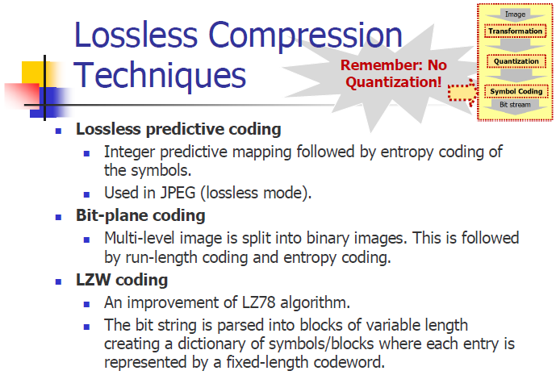

Slide 28
PREDICTIVE CODING
Entropy Reduction Scheme

Slide 29
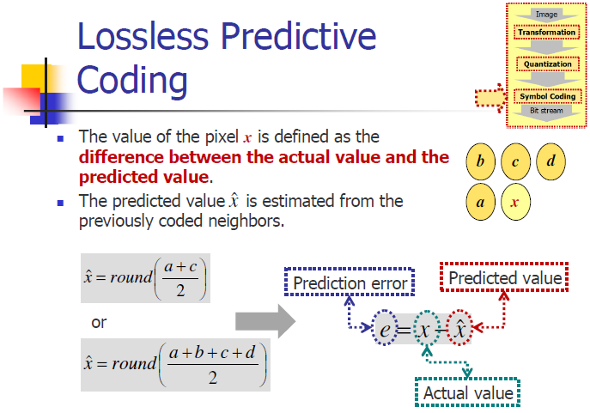

Slide 30
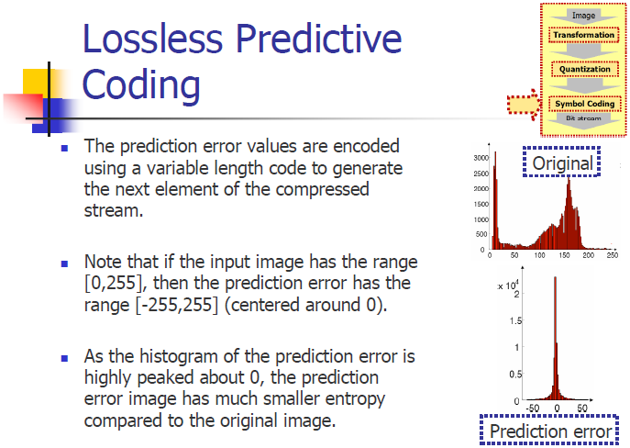

Slide 31
LOSSY COMPRESSION
Fidelity vs Bit-Rate Trade-off Schemes

Slide 32
Lossy Compression
Transform Codecs
Image chopped into small segments
Transformed into a new basis space
Quantized and entropy coded.
Predictive Codecs
Previous and/or subsequent data used to predict the current frame.
Error between predicted and the real data quantized and coded
Extra information needed to decode

Slide 33
DISCRETE COSINE TRANSFORM (DCT)
Image Transform

Slide 34
DCT
Orthonormal Transform
Discrete
Like DFT
Uses only Real Numbers
Unlike DFT (uses complex)
Cosine is more efficient in compression
Compared to sine
Notes:
http://en.wikipedia.org/wiki/Discrete_cosine_transform

Slide 35
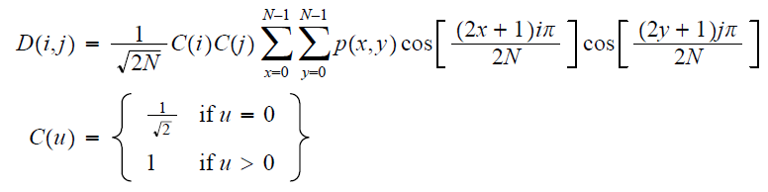
DCT
Expresses a sequence of finitely many data points in terms of a sum of cosine functions oscillating at different frequencies.

Slide 36
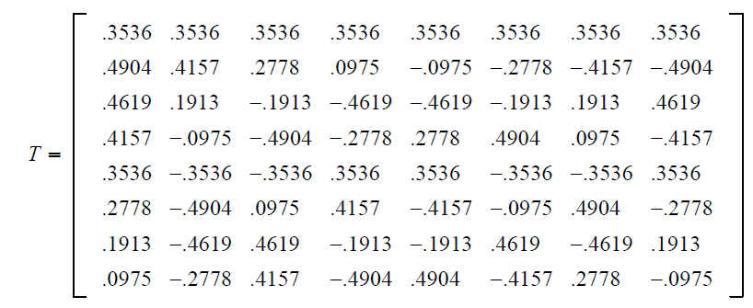
DCT Algorithm
D = TPT’, where P = Level Shifted Image and
General Algorithm when we do DFT

Slide 37
DCT
D(0,0) = Average Value of Image
Called DC Component
D(0,1) = Horizontal Frequency
D(1,0) = Vertical Frequency
D(1,1) = Diagonal Frequency
D(i,j), i>0, j>0
Called AC Components
Typical Image Size = 8 x 8

Slide 38
JPEG FORMAT
Lossy Compression Formats (Gray-Scale & Color Images)

Slide 39
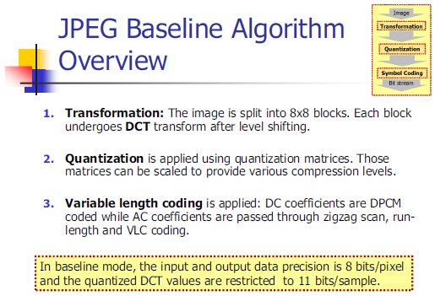
JPEG

Slide 40
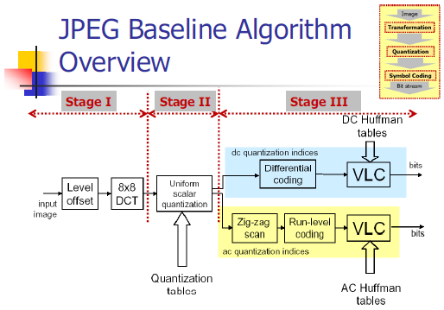
JPEG

Slide 41
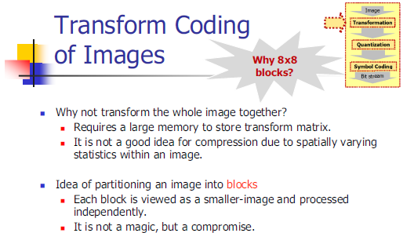
JPEG

Slide 42
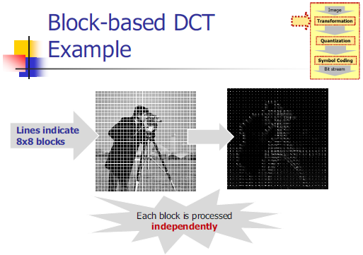
JPEG

Slide 43
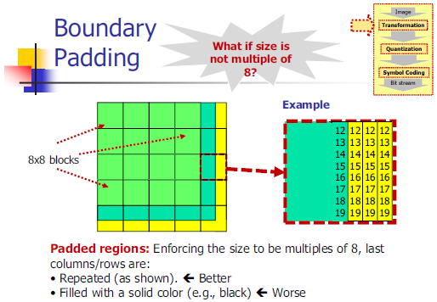
JPEG

Slide 44
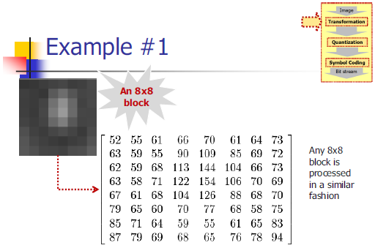
JPEG

Slide 45
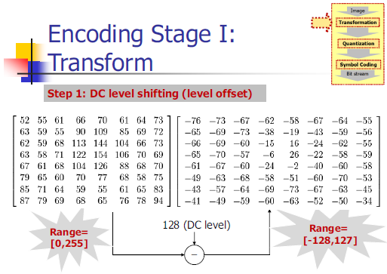
JPEG

Slide 46
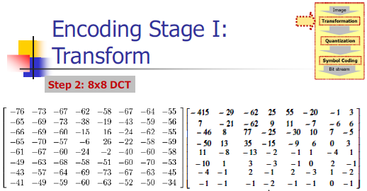
JPEG

Slide 47
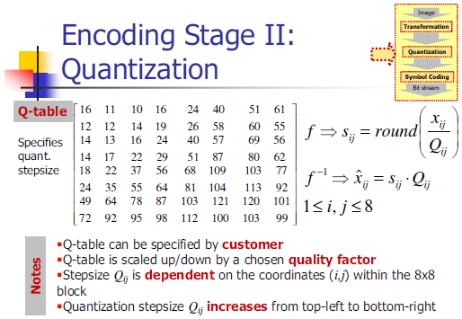
JPEG

Slide 48
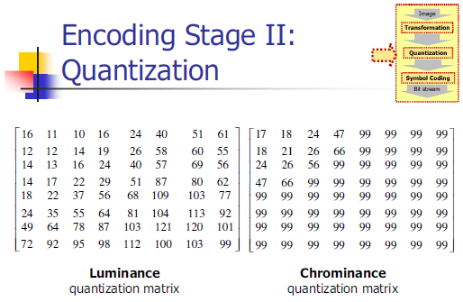
JPEG

Slide 49
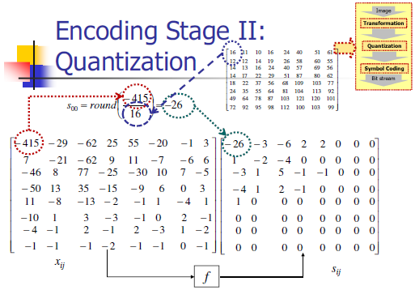
JPEG

Slide 50
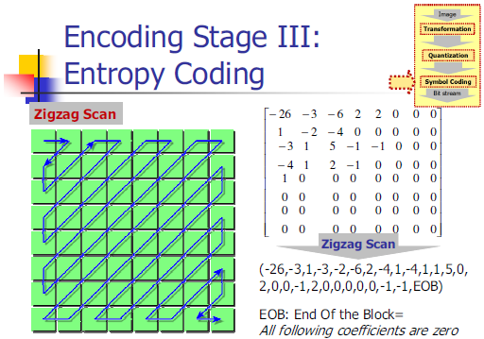
JPEG

Slide 51
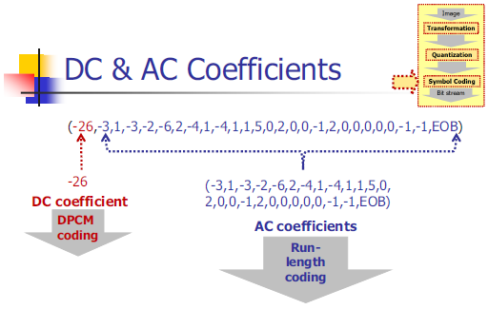
JPEG

Slide 52
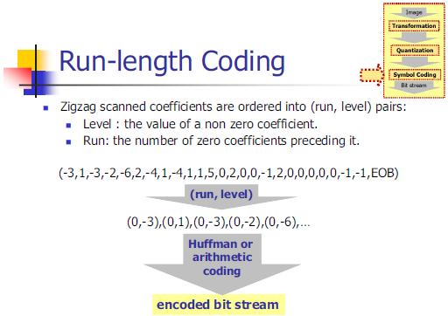
JPEG

Slide 53
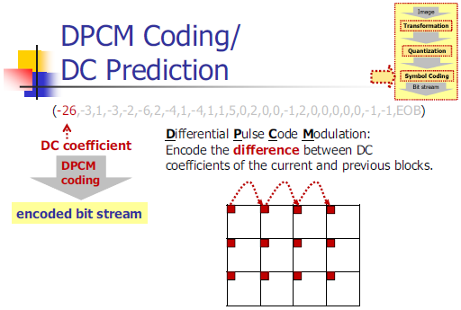
JPEG

Slide 54
JPEG

Slide 55
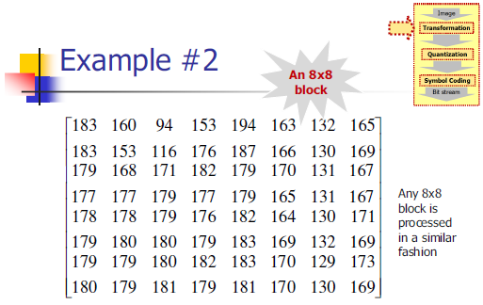
JPEG

Slide 56
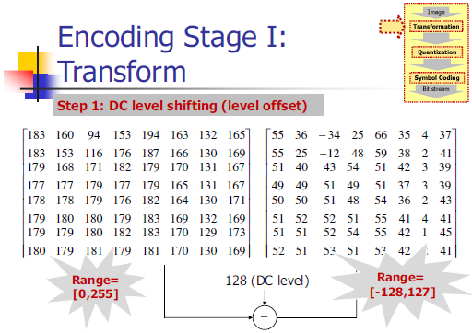
JPEG

Slide 57
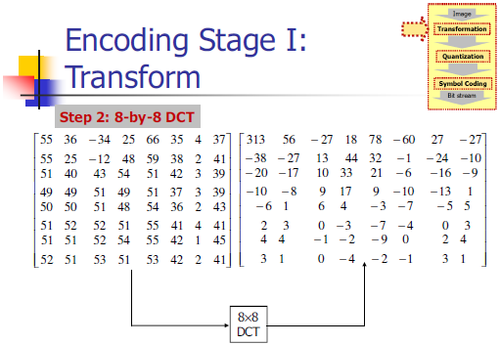
JPEG

Slide 58
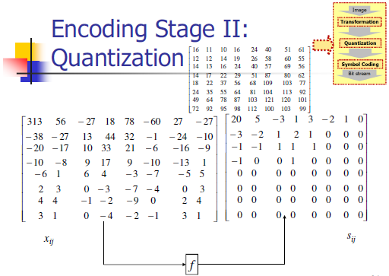
JPEG

Slide 59
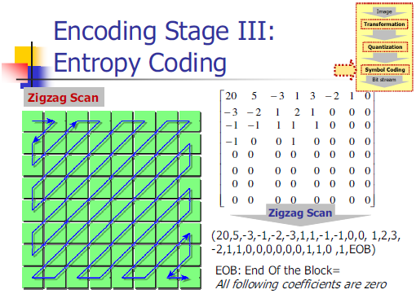
JPEG

Slide 60
JPEG

Slide 61
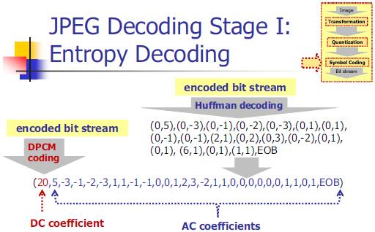
JPEG

Slide 62
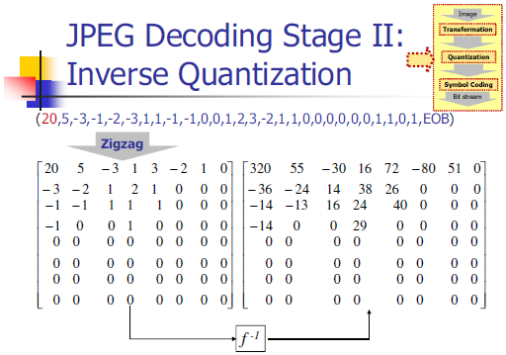
JPEG

Slide 63
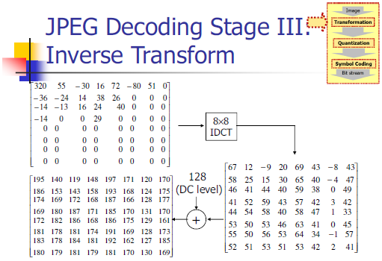
JPEG

Slide 64

JPEG

Slide 65

JPEG

Slide 66
MPEG FORMAT
Lossy Compression Formats (Video)

Slide 67
Video Compression – A Must
A typical progressive scan (non-interlaced) HDTV sequence may have 720 lines and 1280 pixels with 8 bits per luminance and chroma channels.
The data rate corresponding to a frame rate of 60 frames/sec is 720 x 1280 x 3 x 60 = 165 Mbytes/sec!
Notes:
http://www.mediacollege.com/video/format/mpeg/

Slide 68
An Approach to Video Compression (MPEG)
Intraframe compression treats each frame of a sequence as a still image.
Reduces only the spatial redundancies
Interframe compression employs temporal predictions and reduces temporal as well as spatial redundancies
Example: Temporal motion-compensated predictive compression.
Notes:
http://www.mediacollege.com/video/format/mpeg/

Slide 69
MPEG General Information
Goal: data compression 1.5 Mbps
MPEG defines video, audio coding and system data streams with synchronization
MPEG information
Aspect ratios: 1:1 (CRT), 4:3 (NTSC), 16:9 (HDTV)
Refresh frequencies: 23.975, 24, 25, 29.97, 50, 59.94, 60 Hz

Slide 70
MPEG Image Preparation (Resolution and Dimension)
MPEG defines exactly format
Three components: Luminance and two chrominance components (2:1:1)
Resolution of luminance comp:X1 ≤ 768; Y1 ≤ 576 pixels
Pixel precision is 8 bits for each component
Example of Video format:
Luminance: 352x240 pixels, 30 fps;
Chrominance: 176x120 pixels

Slide 71
MPEG Image Preparation - Blocks
Each image is divided into macro-blocks
Macro-block
16x16 pixels for luminance;
8x8 for each chrominance component
Useful for Motion Estimation
Each Macro-block is divided into blocks
Useful for Intra-frame coding

Slide 72

MPEG Video Processing
Intra frames (same as JPEG)
Typically 12 frames between I frames
Predictive frames
Encode from last I or P frame
Bi-directional frames
Encode from last and next I or P frames

Slide 73

MPEG: Spatial & Temporal Redundancy

Slide 74
Selecting I, P, or B Frames
Heuristics
Change of scenes should generate I frame
Limit B and P frames between I frames
B frames are computationally intense
Type | Size | Compress
I | 18K | 7:1
P | 6K | 20:1
B | 2.5K | 50:1
Avg | 4.8K | 27:1

